Slide 1
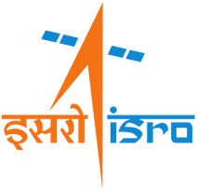

Internship Project Summary
By: Medha Prasad
Guide: Shri Anil Yadav

Slide 2

Introduction
Problem Statement + Objective

Slide 3
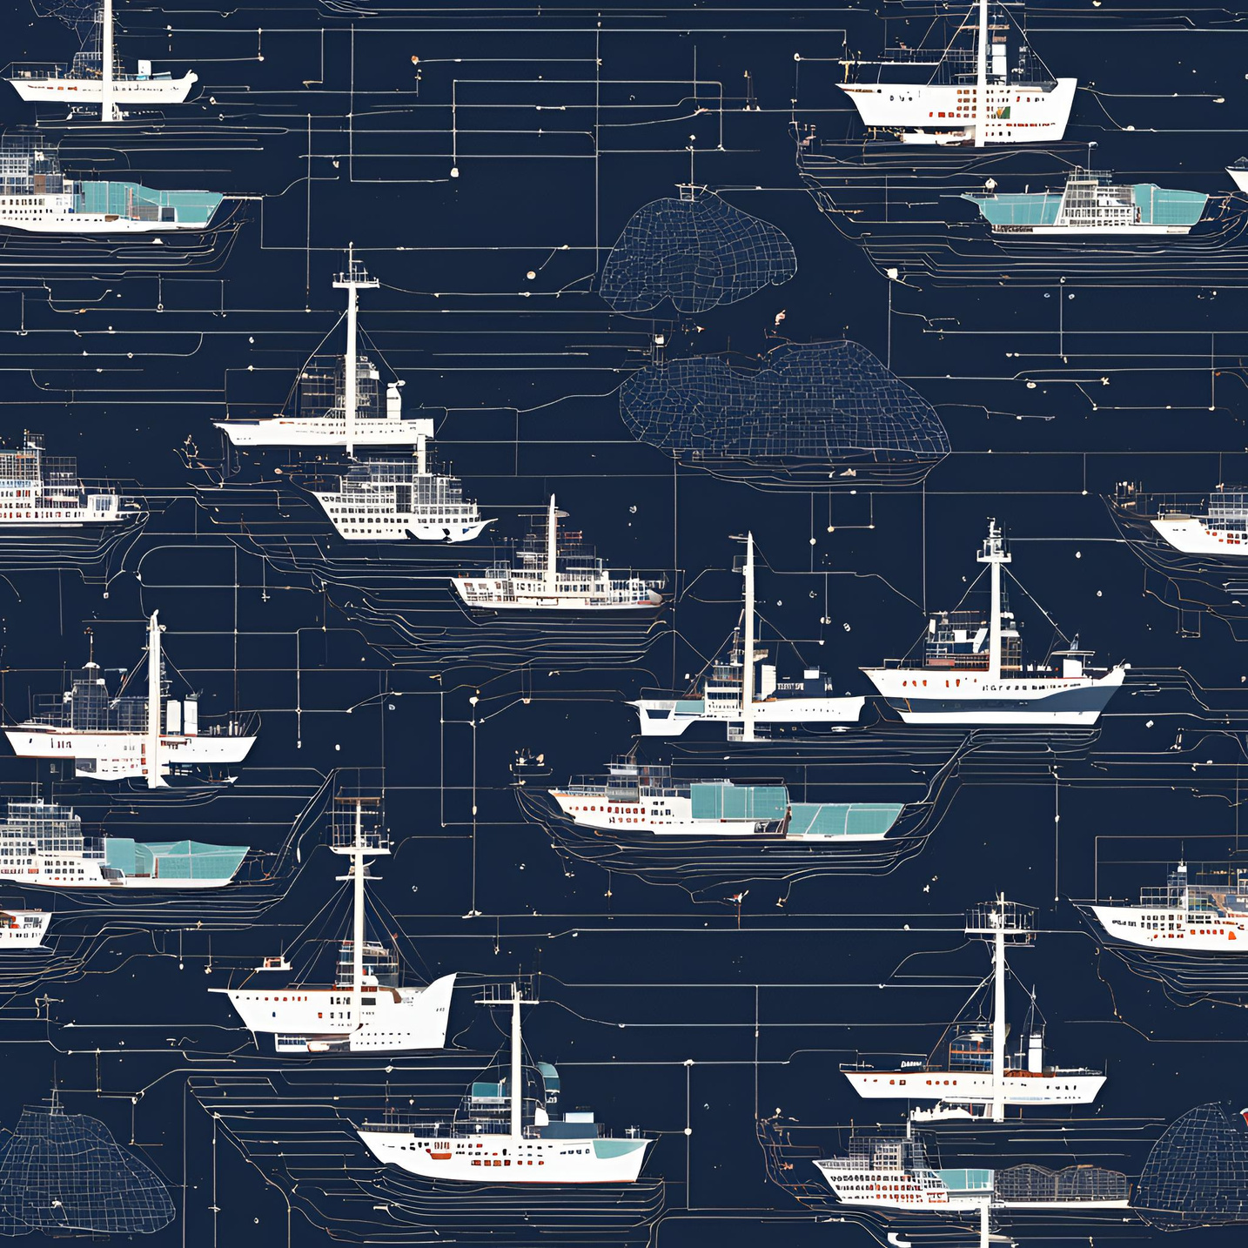
Ship Detection in S1 SAR Imagery Using DL
Ship detection from remote sensing imagery is essential for maritime security, encompassing traffic surveillance, combating illegal fisheries, monitoring oil discharges, and overseeing sea pollution. Traditional systems like AIS, LRIT, and VMS aid in vessel tracking but struggle with non-cooperative ships. Using Synthetic Aperture Radar (SAR), enhances surveillance, crucial for global industries such as fishing, shipping, and energy transport. In recent years, there has been a growing focus on automating vessel detection in SAR satellite imagery. Our project contributes to the goal of improve detection accuracy and reliability, by proposing novel preprocessing steps to remove outliers and exploring instance segmentation models trained on SAR image datasets .

Slide 4

Data and Tools
Data Source and Tools Used

Slide 5
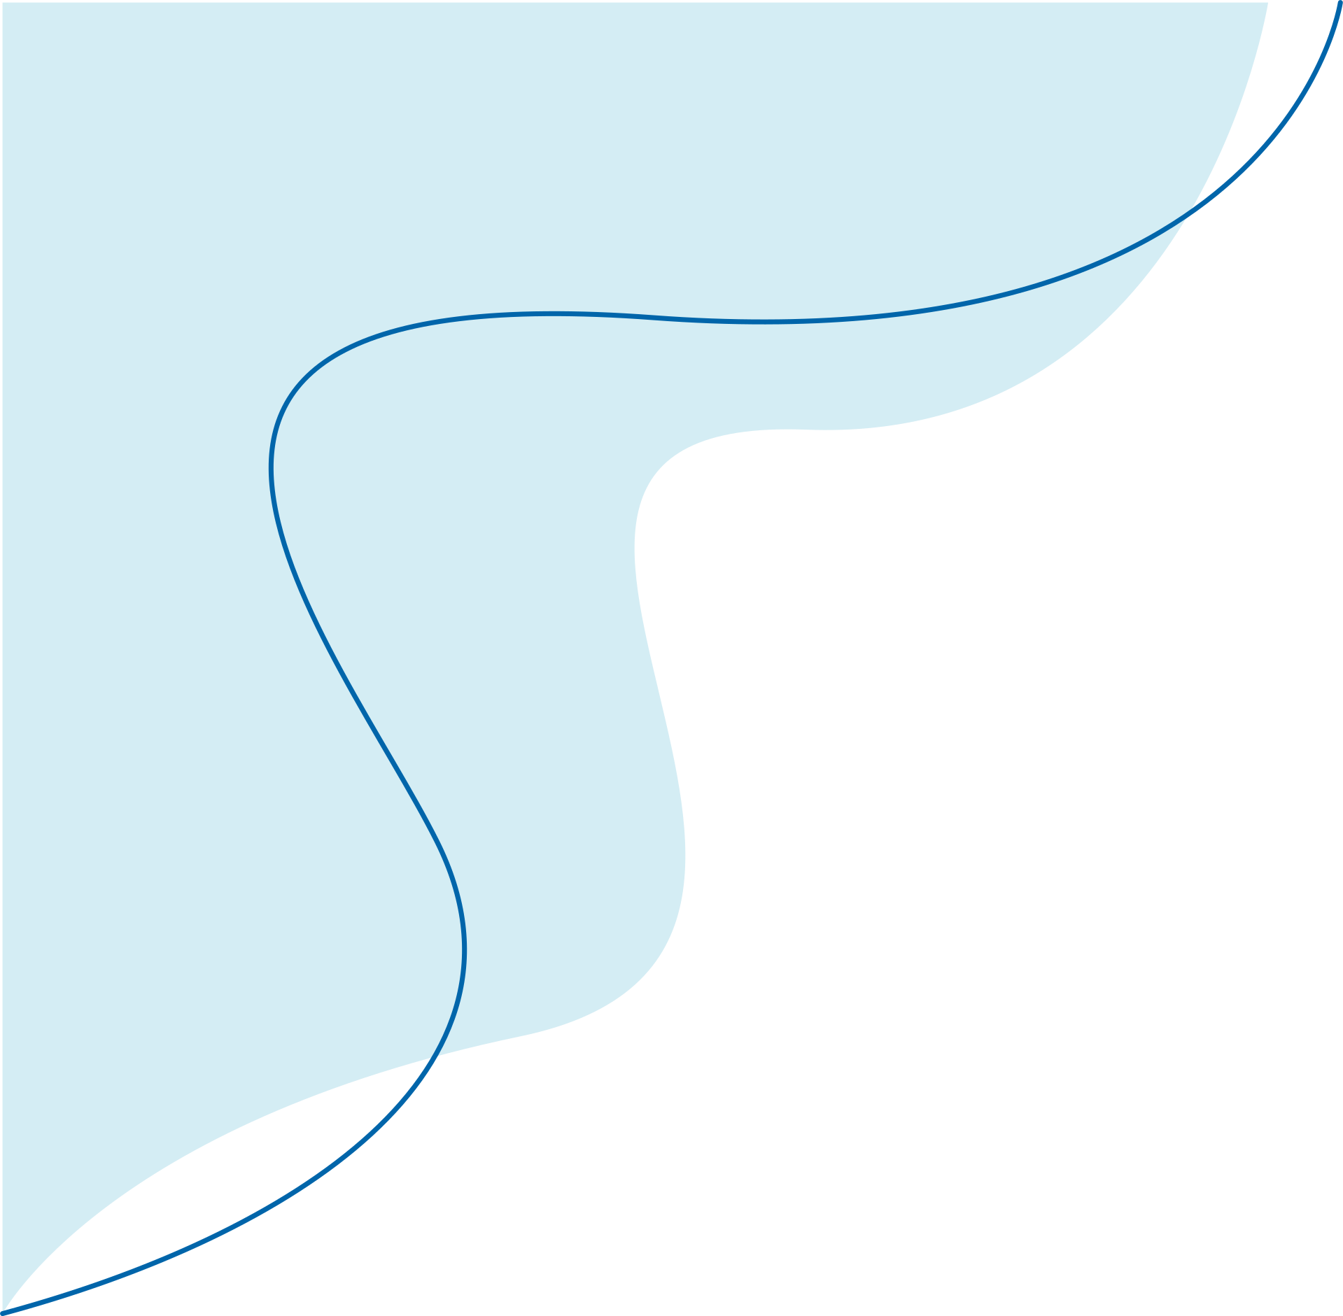





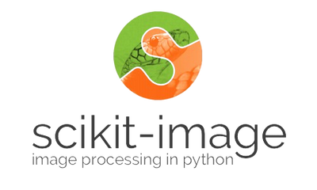





01
02
03
Programming Language
ML and DL Framework
Storage
04
05
Data Source
Image Processing
06
07
Notebooks
Model

Slide 6

Input
Input files from Data Sources

Slide 7

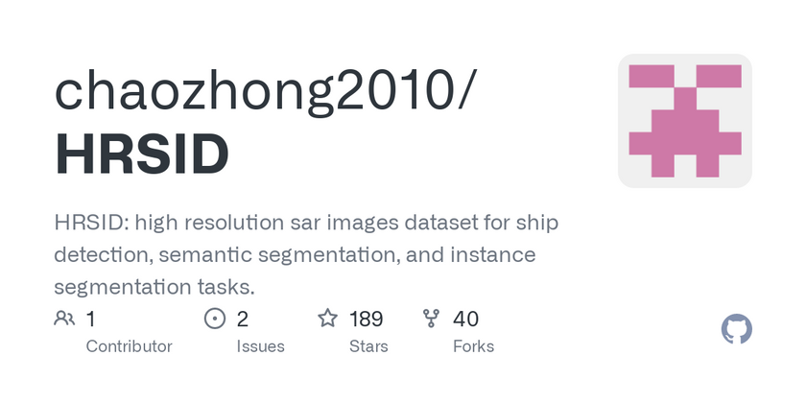
HRSID
High resolution sar images dataset (HRSID) is a data set for ship detection, semantic segmentation, and instance segmentation tasks in high-resolution SAR images. This dataset contains a total of 5604 high-resolution SAR images and 16951 ship instances. HRSID dataset draws on the construction process of the Microsoft Common Objects in Context (COCO) datasets, including SAR images with different resolutions, polarizations, sea conditions, sea areas, and coastal ports. This dataset is a benchmark for researchers to evaluate their approaches.
HRSID_JPG/
JPEGImages/
img1.jpg
img2.jpg
...
annotations/
test2017.json
train2017.json
train_test2017.json
ishore_offshore/
inshore.json
offshore.json
DIRECTORY STRUCTURE OF HRSID_JPG

Slide 8
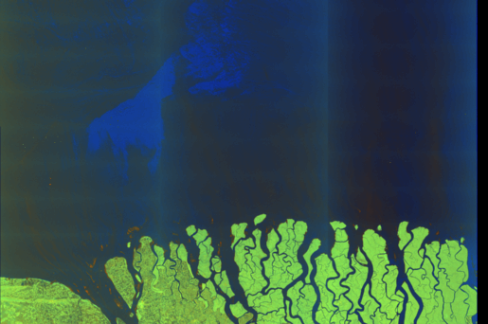
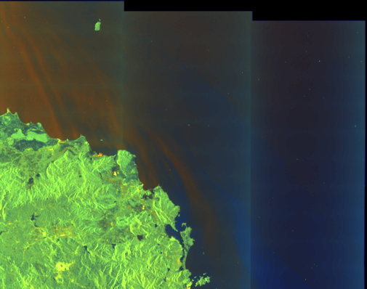
Sentinel-1 product images in ".tiff" format
Satellites:
Sentinel-1A and Sentinel-1B (ESA’s Copernicus Program)
Equipped with: C-band Synthetic Aperture Radar (SAR)
Capabilities: All-weather, day/night data collection
Description of type of P﻿roduct used:
Mission: Sentinel-1A (S1A)
Product Type: Ground Range Detected (GRD)
Beam Mode: Interferometric Wide Swath
Processing Level: 1
Resolution Class: H (high)
Product Class: S (SAR standard)
Polarization: VV + VH
Specific Products Used were from regions in the:
South China Sea
Bay of Bengal
Red Sea
(Data extracted from the measurement folder (VH polarization) within the ".SAFE'' product. Provided in GeoTIFF format for Level-1 products)

Slide 9
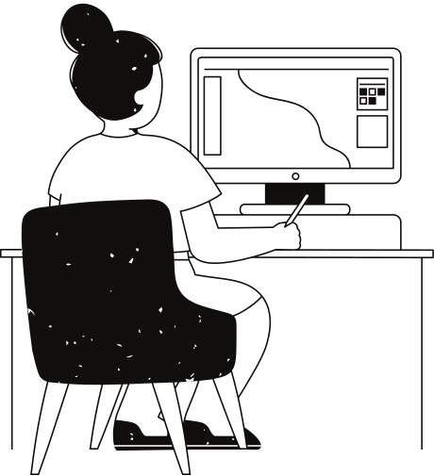
Workflow
Streamlined Efficiency

Slide 10
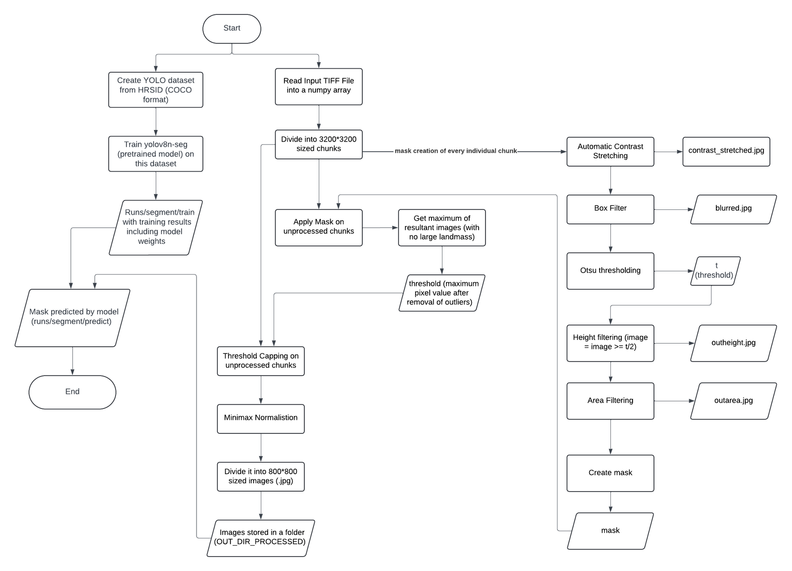

Slide 11

Data Preprocessing
Refined Data

Slide 12
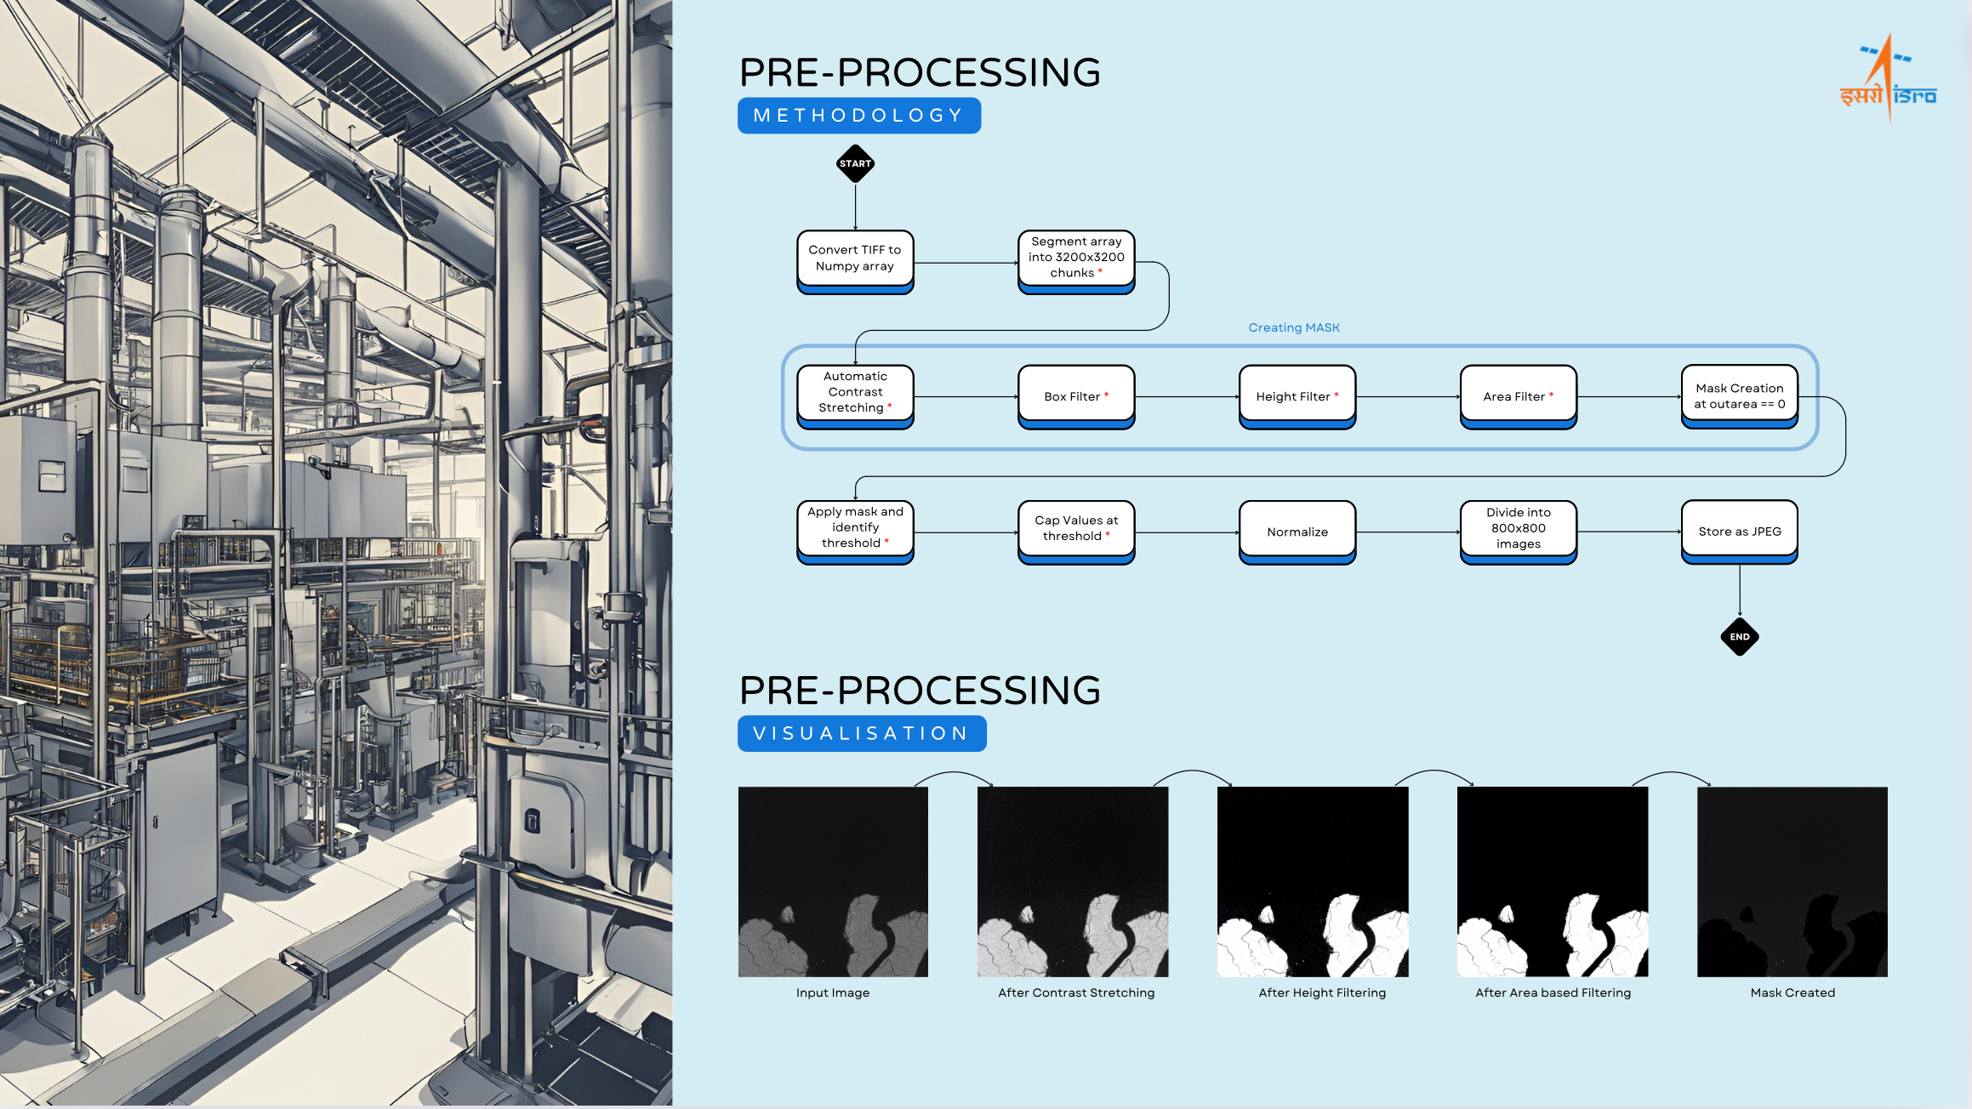
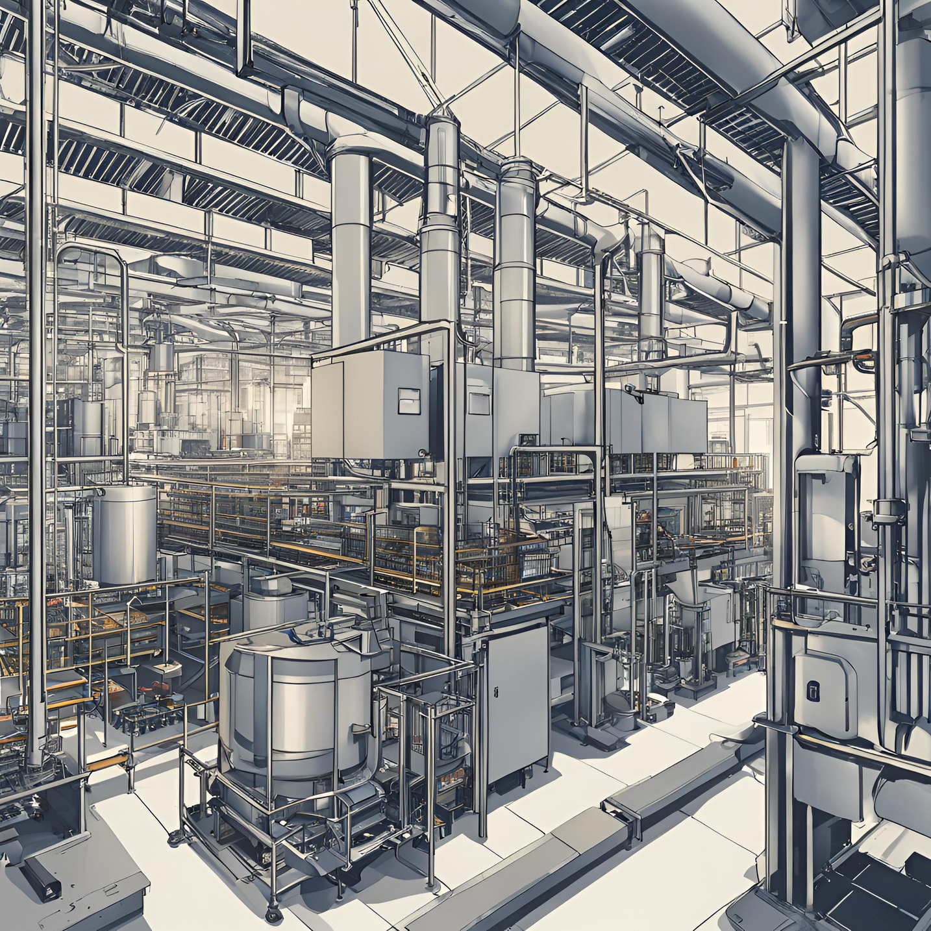
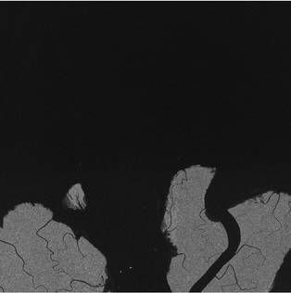
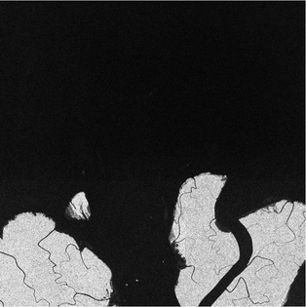
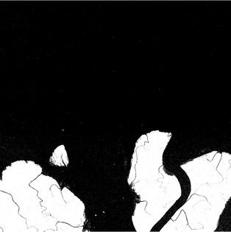
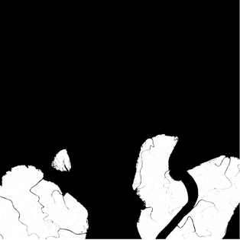
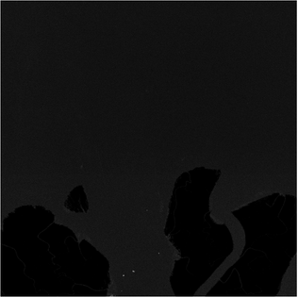
PRE-PROCESSING
METHODOLOGY
START
Convert TIFF to Numpy array
Segment array into 3200x3200 chunks *
Creating MASK
Automatic Contrast Stretching *
Box Filter *
Height Filter *
Area Filter *
Mask Creation at outarea == 0
Apply mask and identify threshold *
Cap Values at threshold *
Normalize
Divide into 800x800 images
Store as JPEG
END
PRE-PROCESSING
VISUALISATION
Input Image
After Contrast Stretching
After Height Filtering
After Area based Filtering
Mask Created

Slide 13
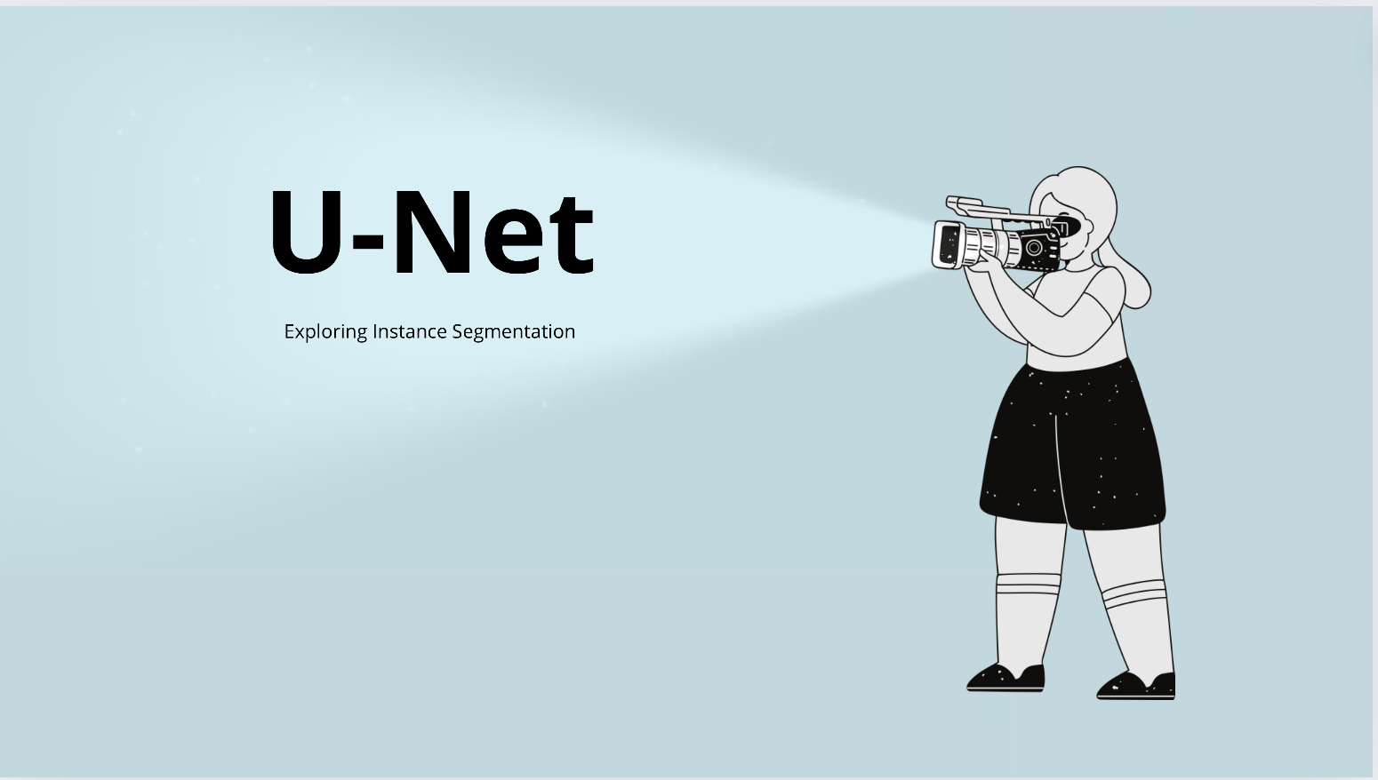

Slide 14
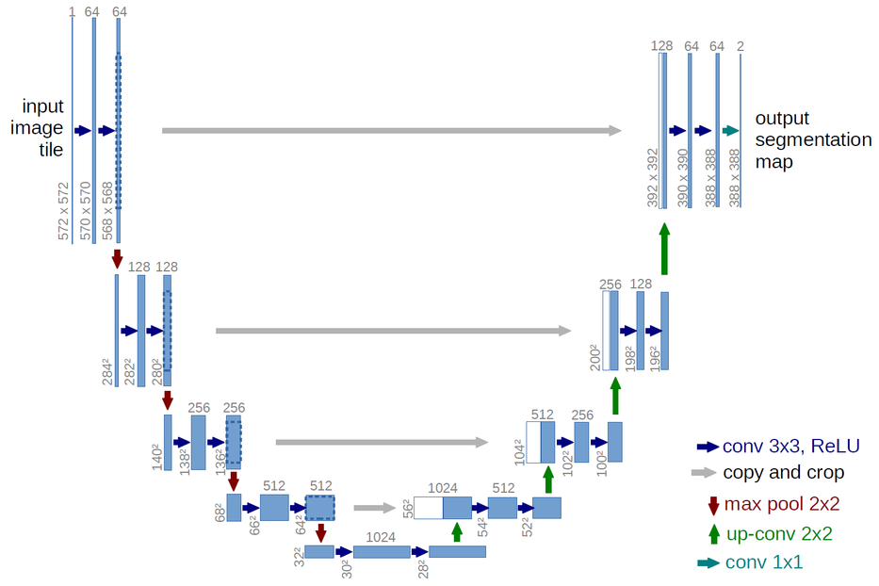
Overview of U-net
Architecture: U-shaped convolutional neural network designed for image segmentation.
Features: Combines high-resolution spatial information (contracting path) with high-level semantic information (expansive path) using skip connections.
Advantages: Effective in capturing context and achieving precise localization, ideal for tasks like ship detection in SAR imagery.
Performance and Pivot to YOLOv8
Observations: U-net showed potential but was constrained by limited resources.
Comparison and decision: It was found that YOLOv8, especially when fine-tuned from a pre-trained model, demonstrated superior performance early in the training process. Shifted focus to YOLOv8 due to its quick and high performance given the project’s requirements.
Future Work
Further Training: Additional training and optimization of U-net could be done with more resources to fully explore its potential for ship detection in SAR imagery.
U-Net Architecture

Slide 15
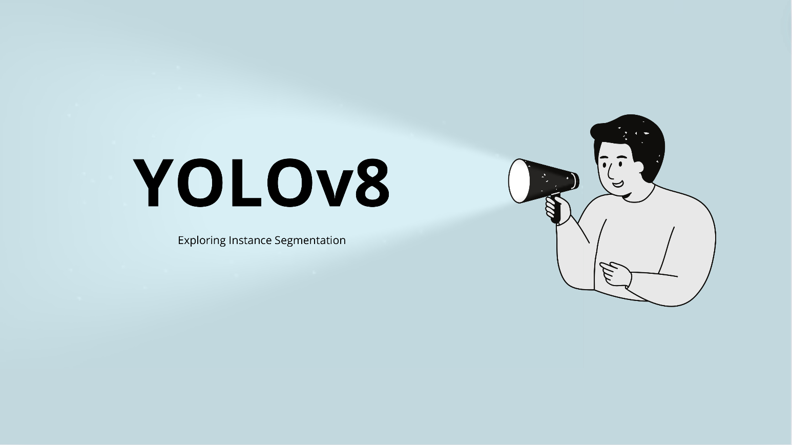

Slide 16
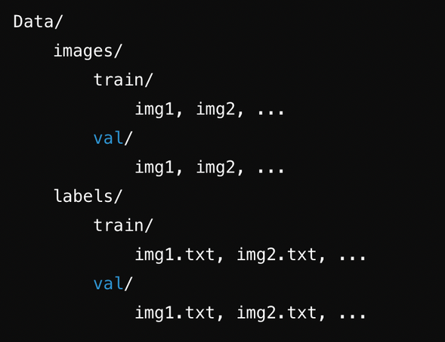
INTRODUCTION TO YOLOv8
Developed by Ultralytics, YOLOv8 is an advanced real-time object detection and image segmentation model.
Built on state-of-the-art deep learning techniques, it excels in speed and accuracy.
Versatile across hardware platforms, from edge devices to cloud APIs.
Capable of object detection, instance segmentation, and image classification tasks.
Implemented in PyTorch, with support for CPUs and GPUs, accessible via Python package and CLI.
PROJECT SETUP AND DATASET PREPARATION
Utilized YOLOv8n-seg, the 'nano' variant, optimized for minimal computational cost.
Dataset: HRSID formatted in MS COCO, split into train and test sets.
Dataset structure described in the photo on the left.
JSON annotations converted from COCO to YOLO format using a custom script.
Config.yaml created to specify dataset paths and training parameters.

Slide 17
Training, Evaluation, and Prediction
YOLOv8n-seg model is trained on the prepared dataset with a batch size 4 for 75 epochs
Results get stored in runs/segment/train
Model weights stored in runs/segment/train/weights (best.pt and last.pt)
Key metrics tracked by YOLOv8 are precision, recall, mAP50 and mAP50-95.
Confidence threshold is chosen based on the precision - recall tradeoff.
After training, the model was evaluated on the validation data (1962 images) with a chosen confidence threshold to ensure reasonable performance metrics.
Results stored in runs/segment/val.
They showed model's ability to accurately identify and segment ships in the validation dataset, with high precision and a reasonable balance between precision and recall.
Finally, the model is used to predict masks for processed image tiles that it has not seen before. These are the tiles created during the data preprocessing step discussed earlier.
The model demonstrated effective ship detection and segmentation on unseen image tiles.
Examples of predictions stored in runs/segment/predict.

Slide 18
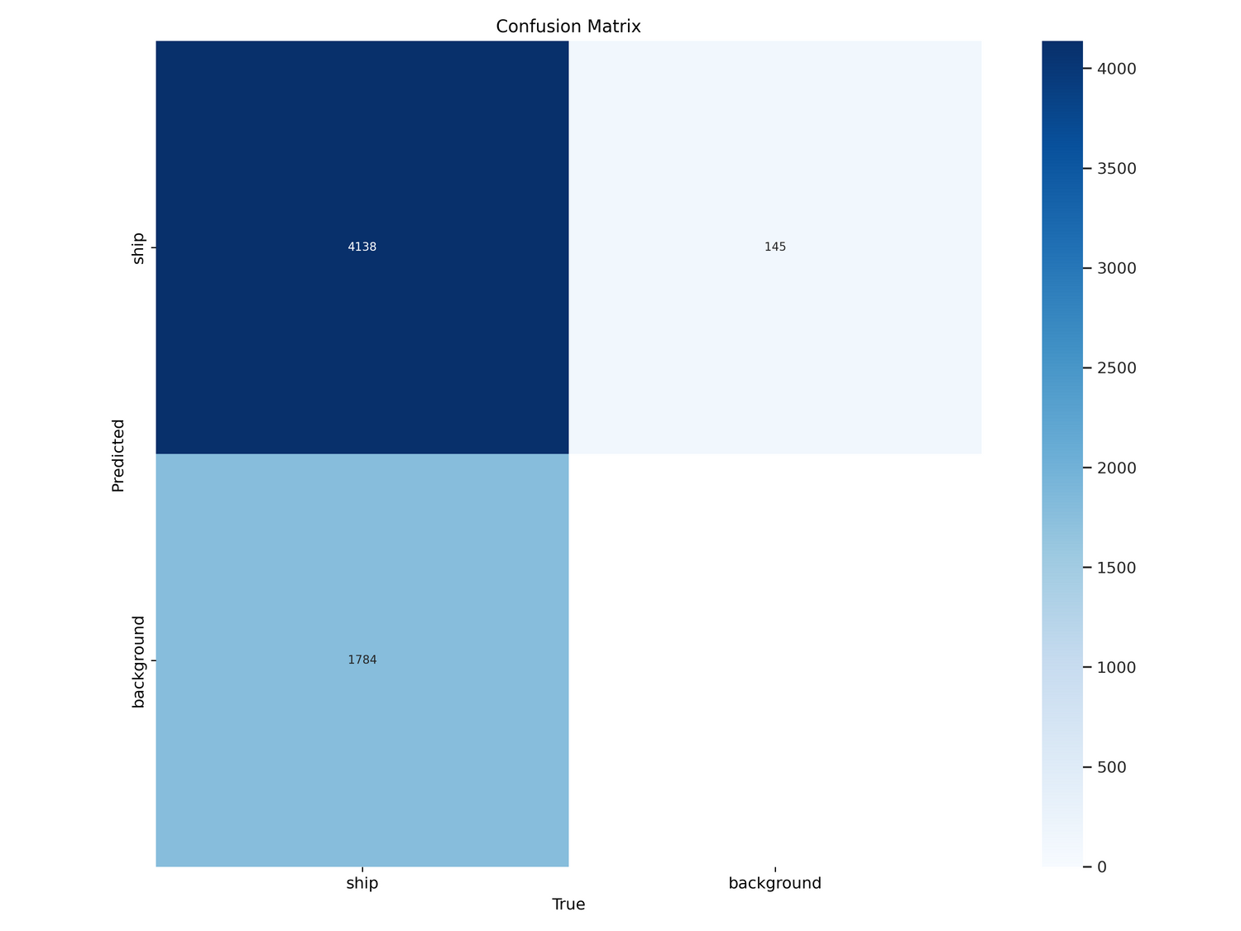
Results on Validation Set
Confusion Matrix Normalised after 75 epochs

Slide 19
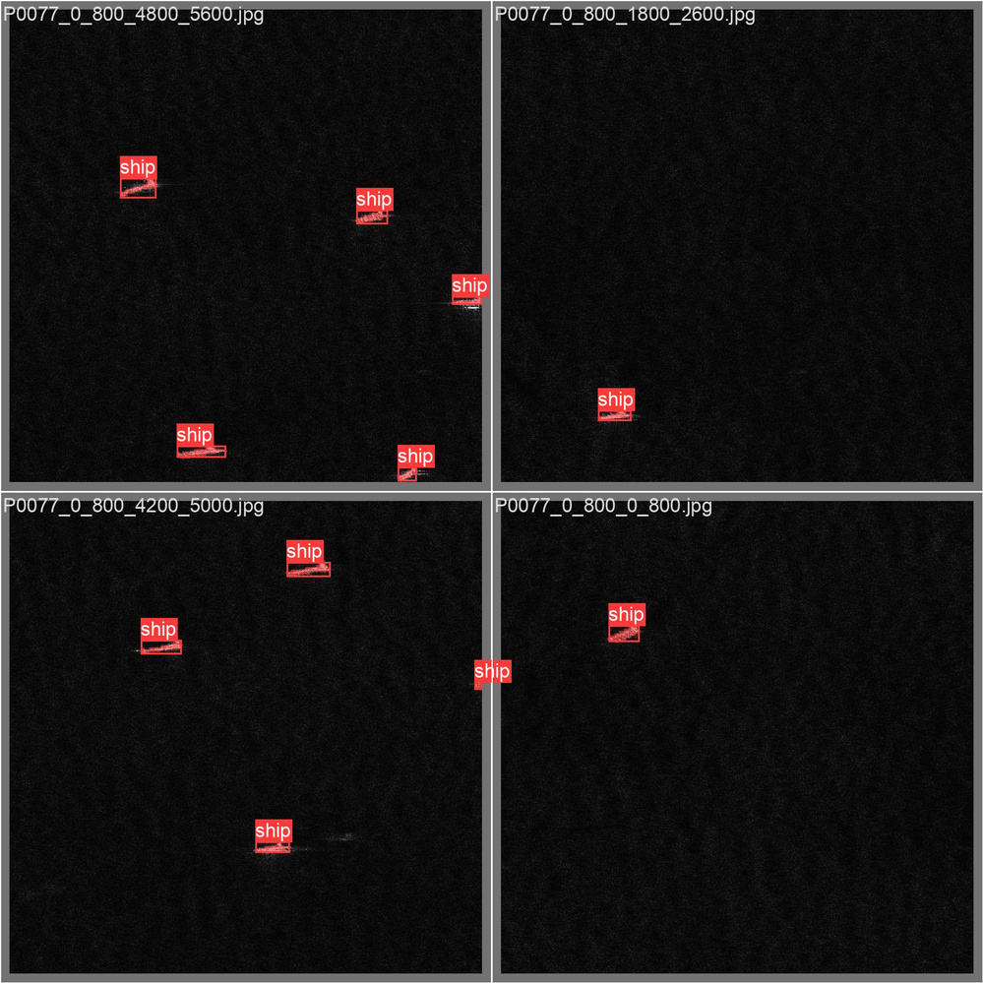
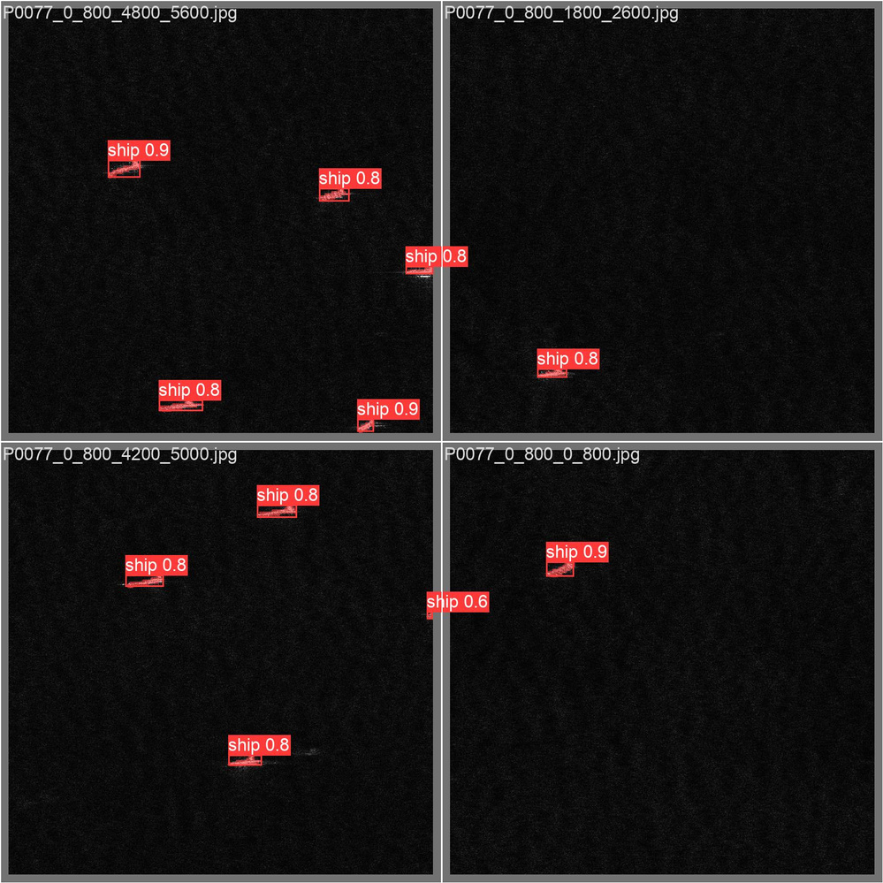
Results on Validation Set
Actual labels (val_batch2)
Predictions
(val_batch2)

Slide 20

Outputs
Some results generated by my model

Slide 21
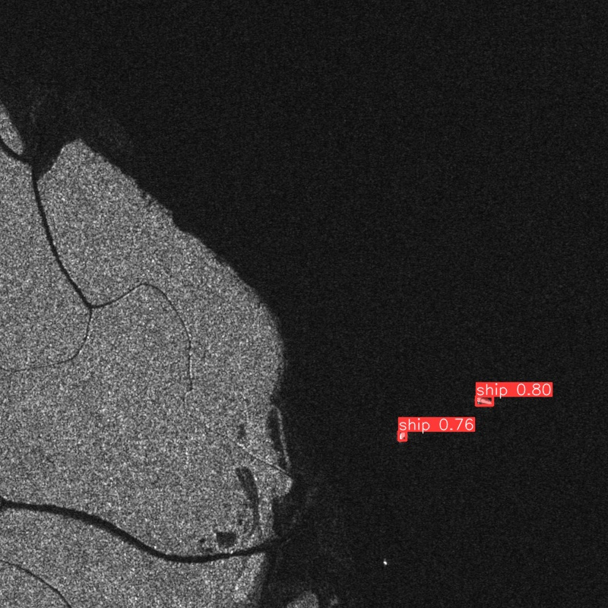
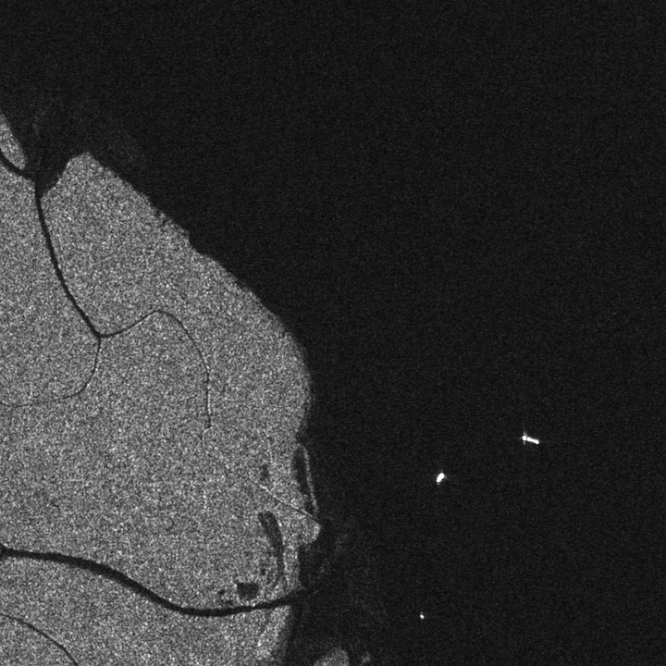
Output 01
Model Prediction
Input Image

Slide 22
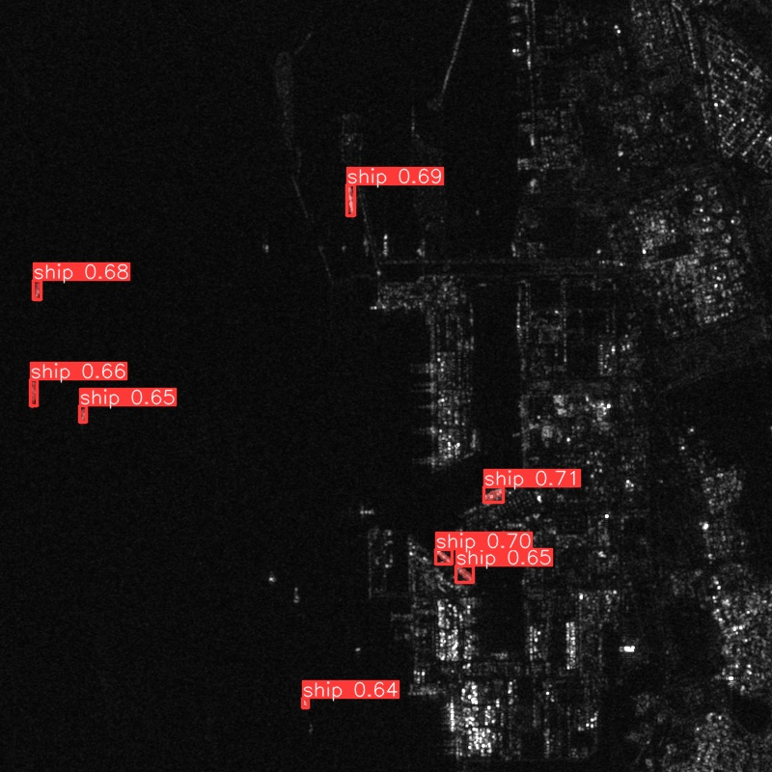
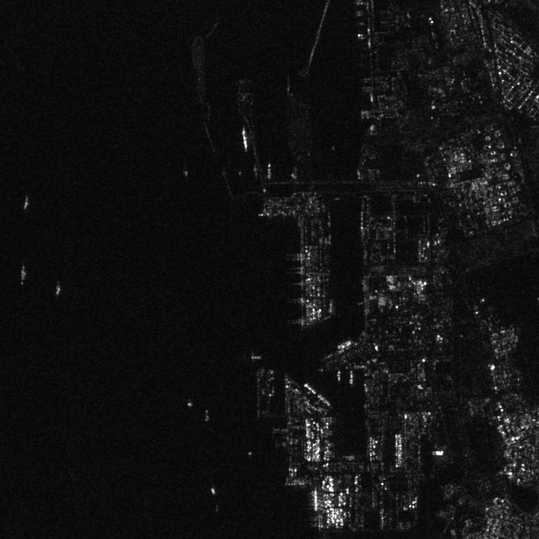
Output 02
Model Prediction
Input Image

Slide 23
CONCLUSION
Results, Limiations, and Recommendations

Slide 24

Results
Limitations and Challenges
Proposed preprocessing techniques to optimize normalization for accurate segmentation.
Utilized mathematical morphology and connected component analysis to successfully filter out high-value pixel outliers from shore areas in SAR imagery preprocessing.
YOLOv8 model demonstrated strong performance:
Bounding Box Prediction: P=0.967, R=0.739, mAP50=0.86, mAP50-95=0.683
Mask Prediction: P=0.923, R=0.705, mAP50=0.831, mAP50-95=0.527
The model successfully detects and segments ships for processed image tiles it has not encountered before, showing promise for real-world scenarios.
Developed ship detection model pipeline using Sentinel-1 SAR imagery and HRSID dataset, targeting challenges in satellite-based applications.
Training time and storage constraints limited thorough U-net training as training a pretrained yolov8n-seg model proved to be more efficient and in alignment with the project goals
Batch size restricted to 4 due to resource limitations.
The base model (uolov8n-seg) was chosen due to resource constraints.
An exact quantification of the difference in model prediction for preprocessed and unprocessed images could not be done.

Slide 25




Extend training periods and increase batch sizes for enhanced model performance.
Implement advanced data augmentation techniques to enhance model generalization.
Recommendations
Explore custom YOLO model development for fine-tuned ship detection parameters.
Explorating and incorporating further preprocessing methods and testing it on diverse sea conditions

Slide 26
References
Relevant Literature

Slide 27
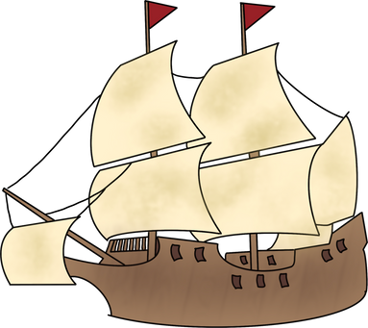

Corbane, C., Najman, L., & Pecoul, E. (December 2010). A complete processing chain for ship detection using optical satellite imagery. ResearchGate. Retrieved from https://www.researchgate.net/publication/228346316_A_complete_processing_chain_for_ship _detection_using_optical_satellite_imagery
Zheng, Y., Er, M. J., Yi, G., & Shen, S. (July 2021). RepUNet: A Fast Image Semantic Segmentation Model Based on Convolutional Reparameterization of Ship Satellite Images. In 2021 6th International Conference on Automation, Control and Robotics Engineering (CACRE) (pp. 1-3). DOI: 10.1109/CACRE52464.2021.9501337. Retrieved from https://www.researchgate.net/publication/353809581_RepUNetA_Fast_Image_Semantic_Seg mentation_Model_Based_on_Convolutional_Reparameterization_of_Ship_Satellite_Images
Ronneberger, O., Fischer, P., & Brox, T. (May 2015). U-Net: Convolutional Networks for Biomedical Image Segmentation. arXiv:1505.04597 [cs.CV]. Retrieved from https://arxiv.org/abs/1505.04597
Bezerra, D.X., Lorenzzetti, J.A., & Paes, R.L. (2023). Marine Environmental Impact on CFAR Ship Detection as Measured by Wave Age in SAR Images. Remote Sensing, 15(13), 3441. https://doi.org/10.3390/rs15133441
Jiang, Q., Wang, S., Ziou, D., El-Zaart, A., Rey, M.T., Benie, G.B., & Henschel, M. (1998). Ship Detection in Radarsat SAR Imagery. Proceedings of the 1998 IEEE International Conference on Systems, Man, and Cybernetics (Volume 5). https://doi.org/10.1109/ICSMC.1998.727570

Slide 28
Thank you!

